Slide 1
Distributed Database Systems
Chapter 5
Distributed Database Design (Part 1 of 2)
Distributed Database Systems

Slide 2
Introduction
DDB design
  Making decision on the placement of data across the network Components
  Critical to the performance of DDB and applications
  Input of the design: queries (applications), use case of applications concerned with sites and frequency
  Output of the design: a set of fragments located at different sites
Distributed Database Systems

Slide 3
5.1 Alternative Design Strategies
Distributed Database Systems

Slide 4
5.1.1 Top-down design process
An iteration of five steps:
  Requirement analysis
  Conceptual design and view integration
  E-R representation and translation to RDB schema
  Distribution design
  Data fragmentation and allocation
  Physical design
  Tuning Closely related to architecture issues.
Distributed Database Systems
Notes:
4. Distribution Design: Local Conceptual Schema (LCS)

Slide 5
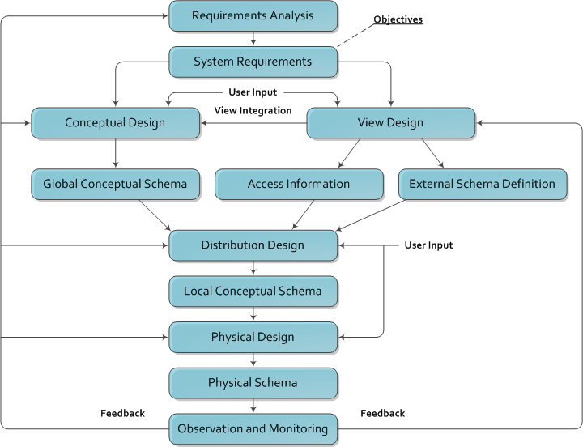
Distributed Database Systems

Slide 6
5.1.2 Bottom-up design process
Primarily for multidatabase applications
It’s been studied for years and becomes very hot today as Internet is penetrating to every aspect of society
Terms related
  Data integration/fusion
  P2P
  Marsh-up\
Not covered by this course
Distributed Database Systems

Slide 7
5.2 Distribution Design Issues
Why to fragment
How to fragment
Correctness of fragmentation
How to allocate
The information for fragmentation
Distributed Database Systems

Slide 8
5.2.1 Reasons for Fragmentation
To enhance intra-query concurrency
To increase the throughput
But extra cost for queries involving more than one segment residing at different sites
Closely related to query processing and optimization
Distributed Database Systems

Slide 9
5.2.2 Fragmentation Alternatives
Horizontal, or vertical, or both
Example:
EMP(Employee)
PAY(Payment)
ASG(Assignment)
ENO | ENAME | TITLE
E1 | J.Doe | Elec. Eng.
E2 | M.Smith | Syst. Anal.
E3 | A.Lee | Mach. Eng.
E4 | J.Miller | Programmer
E5 | B.Casey | Syst. Anal.
E6 | L.Chu | Elec. Eng.
E7 | R.Davis | Mach. Eng.
E8 | J.Jones | Syst. Anal.
TITLE | SAL
Elec. Eng. | 40000
Syst. Anal. | 34000
Mesh. Eng. | 27000
Programmer | 24000
ENO | PNO | RESP | DUR
E1 | P1 | Manager | 12
E2 | P1 | Analyst | 24
E2 | P2 | Analyst | 6
E3 | P3 | Consultant | 10
E3 | P4 | Engineer | 48
E4 | P2 | Programmer | 18
E5 | P2 | Manager | 24
E6 | P4 | Manager | 48
E7 | P3 | Engineer | 36
E8 | P3 | Manager | 40
PROJ(Project)
PNO | PNAME | BUDGET | LOC
P1 | Instrumentation | 150000 | Montreal
P2 | Database Develop | 135000 | New York
P3 | CAD/CAM | 250000 | New York
P4 | Maintenance | 310000 | Paris
An engineering database
Distributed Database Systems

Slide 10
5.2.2 Fragmentation Alternatives
Horizontal Partition
PROJ
PNO | PNAME | BUDGET | LOC
P1 | Instrumentation | 150000 | Montreal
P2 | Database Develop | 135000 | New York
P3 | CAD/CAM | 250000 | New York
P4 | Maintenance | 310000 | Paris
All projects with a budget less than 200,000
PROJ_1
PNO | PNAME | BUDGET | LOC
P1 | Instrumentation | 150000 | Montreal
P2 | Database Develop | 135000 | New York
All projects with a budget more than 200,000
PROJ_2
PNO | PNAME | BUDGET | LOC
P3 | CAD/CAM | 250000 | New York
P4 | Maintenance | 310000 | Paris
Distributed Database Systems

Slide 11
5.2.2 Fragmentation Alternatives
Vertical Partition
PROJ
PNO | PNAME | BUDGET | LOC
P1 | Instrumentation | 150000 | Montreal
P2 | Database Develop | 135000 | New York
P3 | CAD/CAM | 250000 | New York
P4 | Maintenance | 310000 | Paris
PROJ_1
PROJ_2
PNO | PNAME
J1 | Instrumentation
J2 | Database Develop
J3 | CAD/CAM
J4 | Maintenance
PNO | BUDGET | LOC
J1 | 150000 | Montreal
J2 | 135000 | New York
J3 | 250000 | New York
J4 | 310000 | Paris
Distributed Database Systems

Slide 12
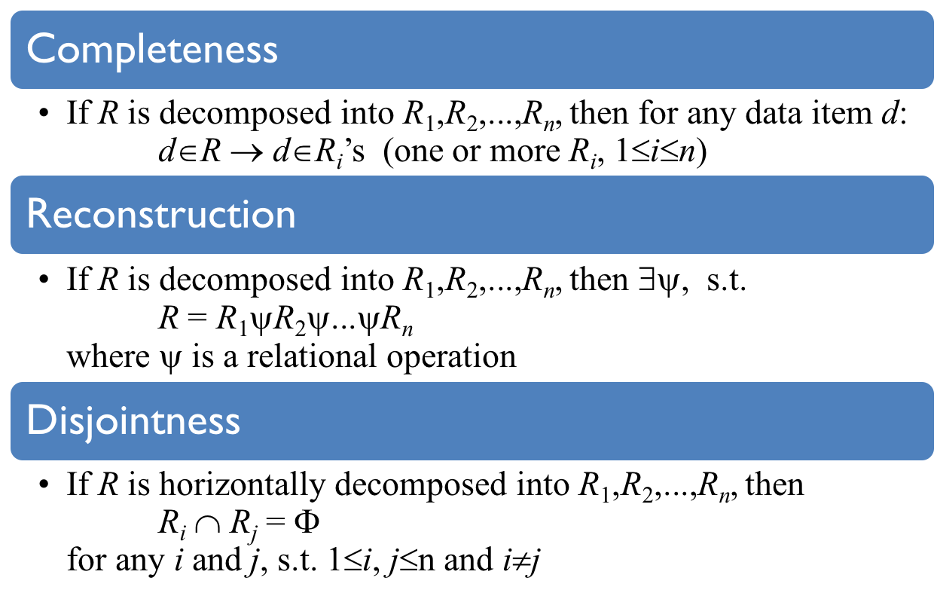
5.2.3 Correctness for Rules of Fragmentation
Distributed Database Systems
Notes:
Disjointness for horizontal fragmentation / duplicated keys for vertical fragementation

Slide 13
5.3 Fragmentation
Distributed Database Systems

Slide 14
5.3.1 Horizontal Fragmentation
Primary horizontal fragmentation
  To partition a relation by using predicates on that relation
Derived horizontal fragmentation
  To partition a relation by using predicates on another relation
Two aspects affecting fragmentation
  Data information, and
  Application information
Distributed Database Systems

Slide 15
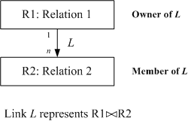
Data Information
The relationships are important for distribution design
Links are used to represent equal joins between relations
Quantitative information on DB – cardinality of relation R: card(R)
Distributed Database Systems

Slide 16
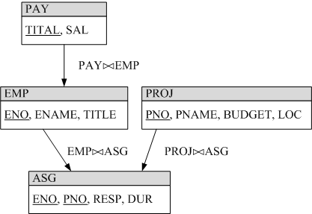
Data Information
Example
Distributed Database Systems

Slide 17

Application Information
Both qualitative and quantitative are needed
Qualitative predicates used in queries
  Simple predicate
  A_{i} θ value over relation R(A₁,A₂,...,A_{n}) where θ∈{≠,<,≤,≥,>} and value ∈D_{i} (domain of A_{i} )
  Minterm predicate – the conjunction of simple predicates
  Given a set of simple predicates for relation Ri, Pri = {Pi₁,Pi₂,_,Pi_{m}}, the set of minterm predicates Mi = {m_{i1},m_{i2},_,m_{iz}} is defined as
  where
Distributed Database Systems

Slide 18
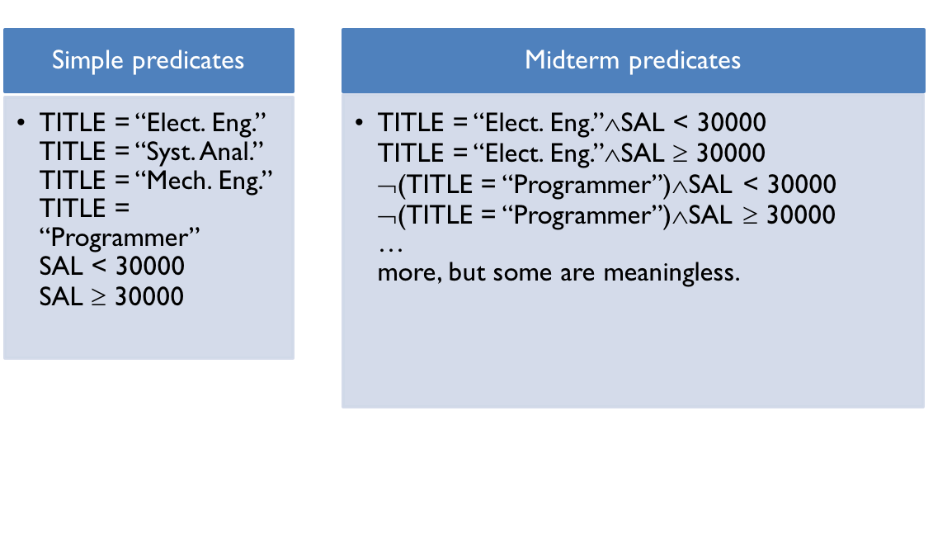
Application Information
Example
Minterm is a general form since it is always possible to translate a Boolean expression into conjunctive normal form.
Distributed Database Systems

Slide 19
Application Information
Attention for negation
  Negation of equality is meaningful
    ¬(Attribute = Value)
  Negation of inequality can be changed to its complement, e.g.
    ¬(Attribute ≤ Value) is changed to (Attribute > Value)
To keep simple predicate assumption, the form Value1 ≤ Attribute ≤ Value2 is excluded
Distributed Database Systems

Slide 20
Application Information
Quantitative information
  Minterm selectivity – sel(m_{i})
    The number of tuples of a relation returned by a query specified by the minterm m_{i}
  Access frequency – acc(m_{i})
    The frequency with which user applications access data using a query specified by the minterm m_{i}
Distributed Database Systems

Slide 21
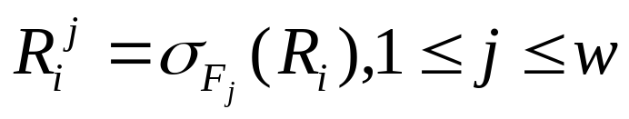
Primary Horizontal Fragmentation
A Primary horizontal fragmentation is defined by a selection operation on the owner relation of a DB schema
where R_{i} is a relation and F_{j} is a minterm predicate, w is the total number of fragments.
Distributed Database Systems

Slide 22
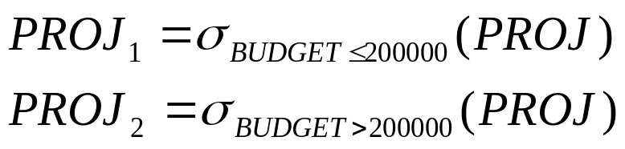
Primary Horizontal Fragmentation
Example
  The fragmentation of PROJ in the engineering database:
  where PROJ₁ and PROJ₂ are called horizontal fragment
Distributed Database Systems

Slide 23
Primary Horizontal Fragmentation
- First Step
The first step for primary horizontal fragmentation is to find a set of simple predicates with the properties of
Completeness and Minimanity
Distributed Database Systems

Slide 24
Completeness
A set of predicate Pr is complete iff there is an equal probability of access by any application to any two tuples belonging to any minterm fragment that is defined according to Pr.
Note: this formal definition requires to specify the access probability for each tuple of relation for each application, which is considerably more work than the common sense and experience of the designer.
Distributed Database Systems

Slide 25
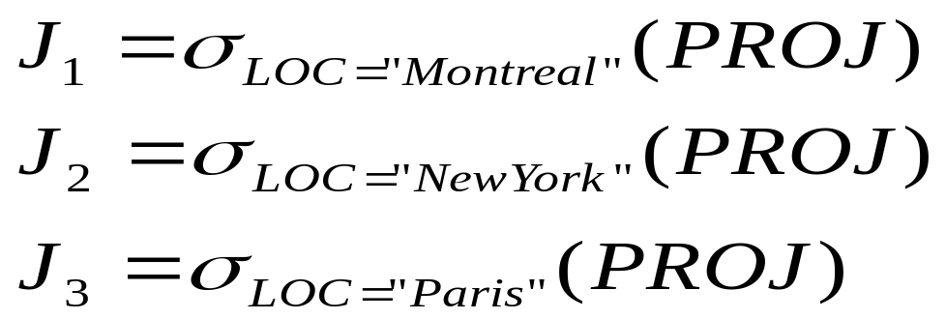
Completeness
Example
  Pr = { LOC = “Montreal”,
  LOC = “New York”,
  LOC = “Paris”}
Distributed Database Systems

Slide 26
Completeness
If there is one and only one application that accesses J according to the location, then Pr is complete
An application accessing PROJ according to BUDGET < 200000 will make Pr incomplete (why?). But
  Pr = {LOC = “Montreal”, LOC = “New York”,LOC = “Paris”, BUDGET < 200000, BUDGET ≥ 200000}
is complete.
Distributed Database Systems
Notes:
As the data distribution based on BUDGET is unknown!

Slide 27
Completeness
Reasons for completeness
  logically uniform and statistically homogeneous.
Distributed Database Systems

Slide 28
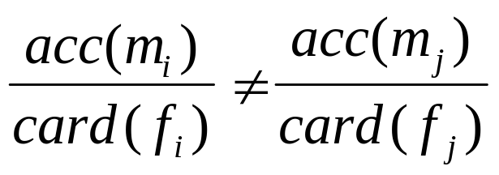
Minimanity
Let
  m_{i} contains p_{i}, determines f_{i}, and
  m_{j} contains ¬p_{i}, determines f_{j}
Pi is relevant iff
A set of simple predicates Pr is minimal if all of its predicates are relevant.
Distributed Database Systems
Notes:
This definition is very formal and difficult to realize. Therefore, intuition and expertise are encouraged to use.

Slide 29
A rule for COM_MIN algorithm
Rule 1: a relation or fragment must be partitioned "into at least two parts which are accessed by at least one application differently"
Notation fi of Pr’: fragment fi defined by a minterm predicate Pr’
COM_MIN

Slide 30
Primary Horizontal Fragmentation
- 2nd Step
To derive the set of minterm predicates -- trivial.
Minterm predicates are exponential on the number of simple predicates.

Slide 31

Primary Horizontal Fragmentation
- 3rd Step
To eliminate meaningless minterm predicates by identifying those that contradict to a set of implications I.
Example
={att=value_1, att=value_2}
domain(att)={value_1, value_2}
I:

Slide 32
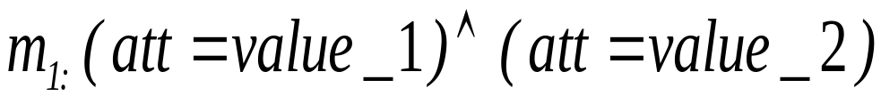
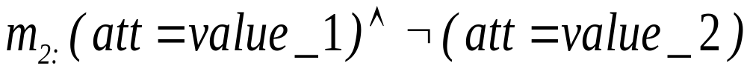
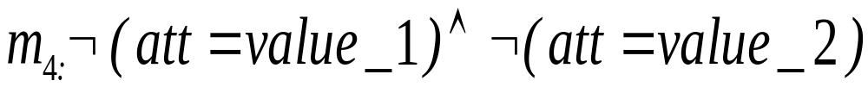
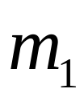
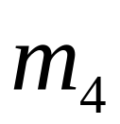
Four minterm predicates generated from
and
are contradictory to I.

Slide 33
Algorithm for PHORIZONTAL
PHORIZONTAL

Slide 34
Example for Primary Horizontal Fragmentation
Example: Horizontal fragmentation of J in the engineering database
Application 1
  Issue at 3 sites and finds the names and budget of project according to the sites.
  SELECT JNAME, BUDGET
  FROM PROJ
  WHERE LOC = value
  Simple predicates:
  p₁ : LOC = “Montreal”
  p₂ : LOC = “New York”
  p₃ : LOC = “Paris”
Distributed Database Systems

Slide 35
Example for Primary Horizontal Fragmentation
Application 2
  Issued at 2 sites, one manages projects with budgets less than 200000, the other manages the rest projects.
  SELECT *
  FROM PROJ
  WHERE BUDGET θ value
  Simple predicates:
  p₄ : BUDGET ≤ 200000
  p₅ : BUDGET > 200000
Distributed Database Systems

Slide 36
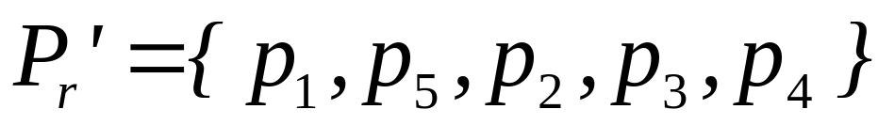
Example for Primary Horizontal Fragmentation
Use COM_MIN algorithm to get a complete and minimal simple predicates
Distributed Database Systems

Slide 37
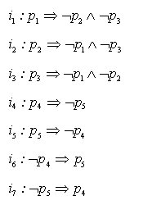
Example for Primary Horizontal Fragmentation
Implications I derived from P_{r}’
Distributed Database Systems

Slide 38

Example for Primary Horizontal Fragmentation
From P_{r}’, 2^5 = 32 minterm predicates can be generated; However, only the following 6 are left due to I:
  m₁ : (LOC="Montreal") (BUDGET≤200000)
  m₂ : (LOC="Montreal") (BUDGET>200000)
  m₃ : (LOC="New York") (BUDGET≤200000)
  m₄ : (LOC="New York") (BUDGET>200000)
  m₅ : (LOC="Paris") (BUDGET≤200000)
  m₆ : (LOC="Paris") (BUDGET>200000)
Distributed Database Systems

Slide 39
Example for Primary Horizontal Fragmentation
Note that m_{i}’s are simplified version by using I, e.g.
Distributed Database Systems

Slide 40
Example for Primary Horizontal Fragmentation
Fragment J according to m_{i}:
  SELECT *
  FROM PROJ
  WHERE m_{i}
  J1={(P1,Instrumentation,150000,Montreal)}
  J2={}
  J3={(P2,Database Develop,135000,New York)}
  J4={(P3,CAD/CAM,250000,New York)}
  J5={}
  J6={(P4,Maintenance,310000,Paris)}
Distributed Database Systems

Slide 41
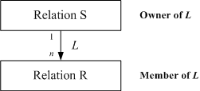
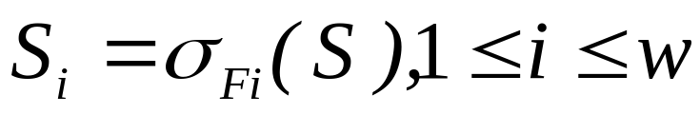
Derived Horizontal Fragmentation
Defined on a member relation of a link according to a σ operation specified on the owner
Distributed Database Systems

Slide 42


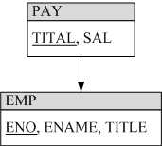
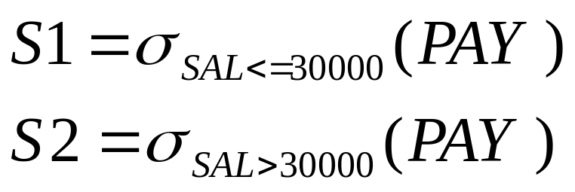

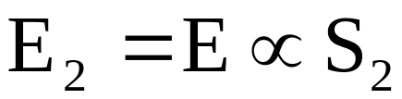
Derived Horizontal Fragmentation
The derived fragmentation of R
Example
E is fragmented according to S1 and S2
Distributed Database Systems

